Slide 1

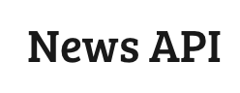
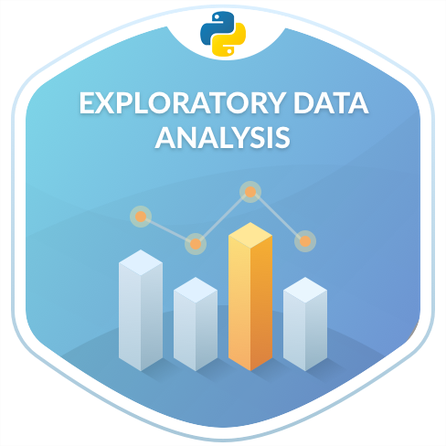
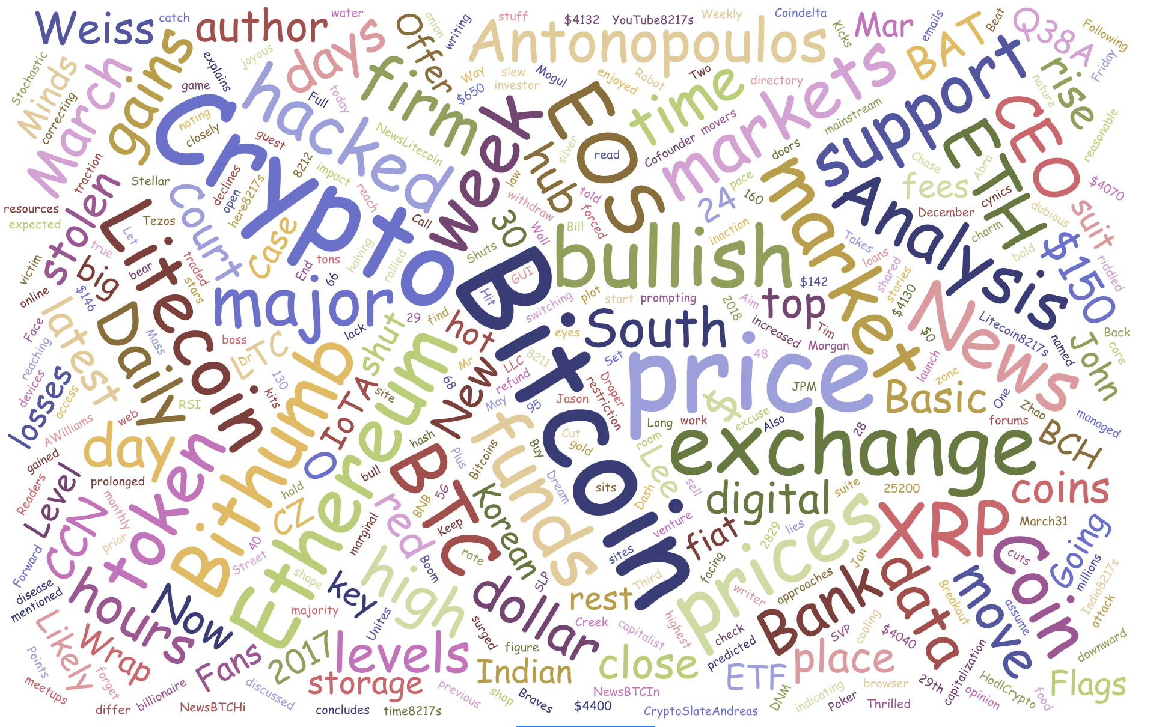

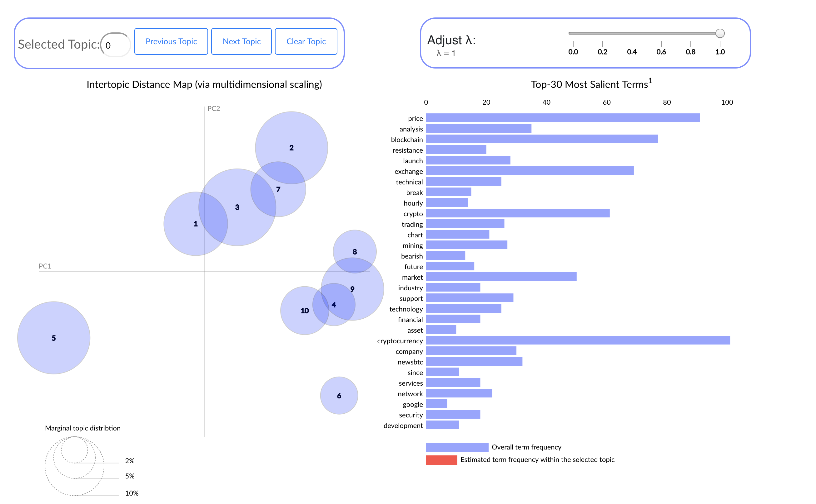
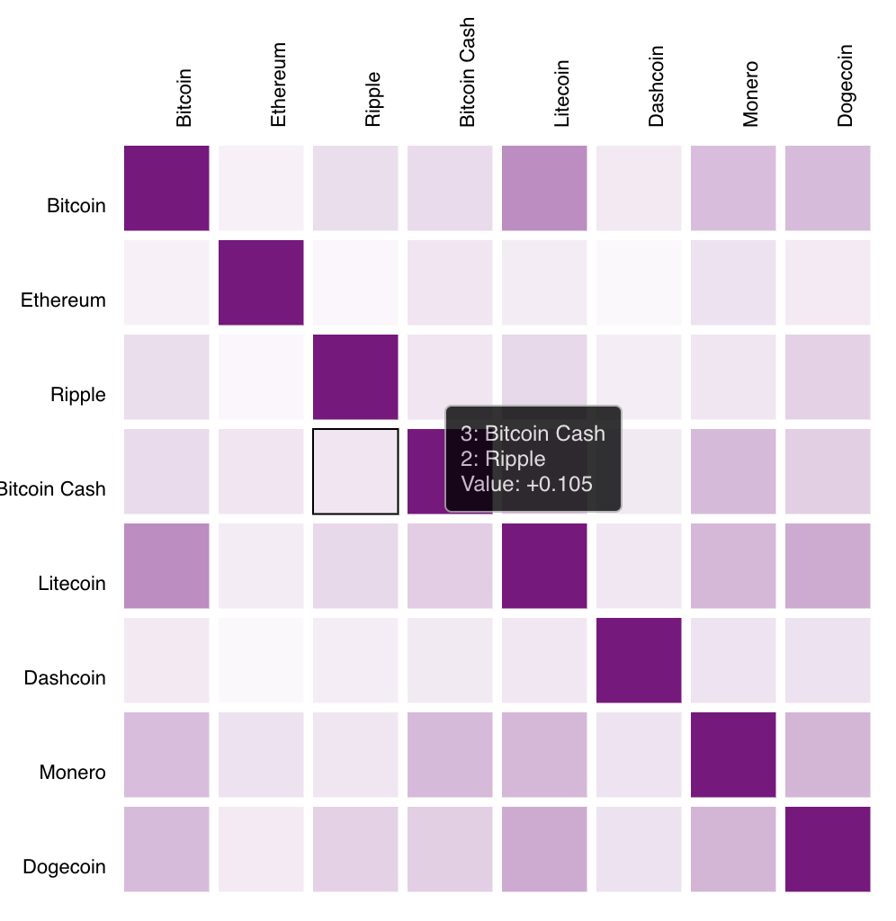


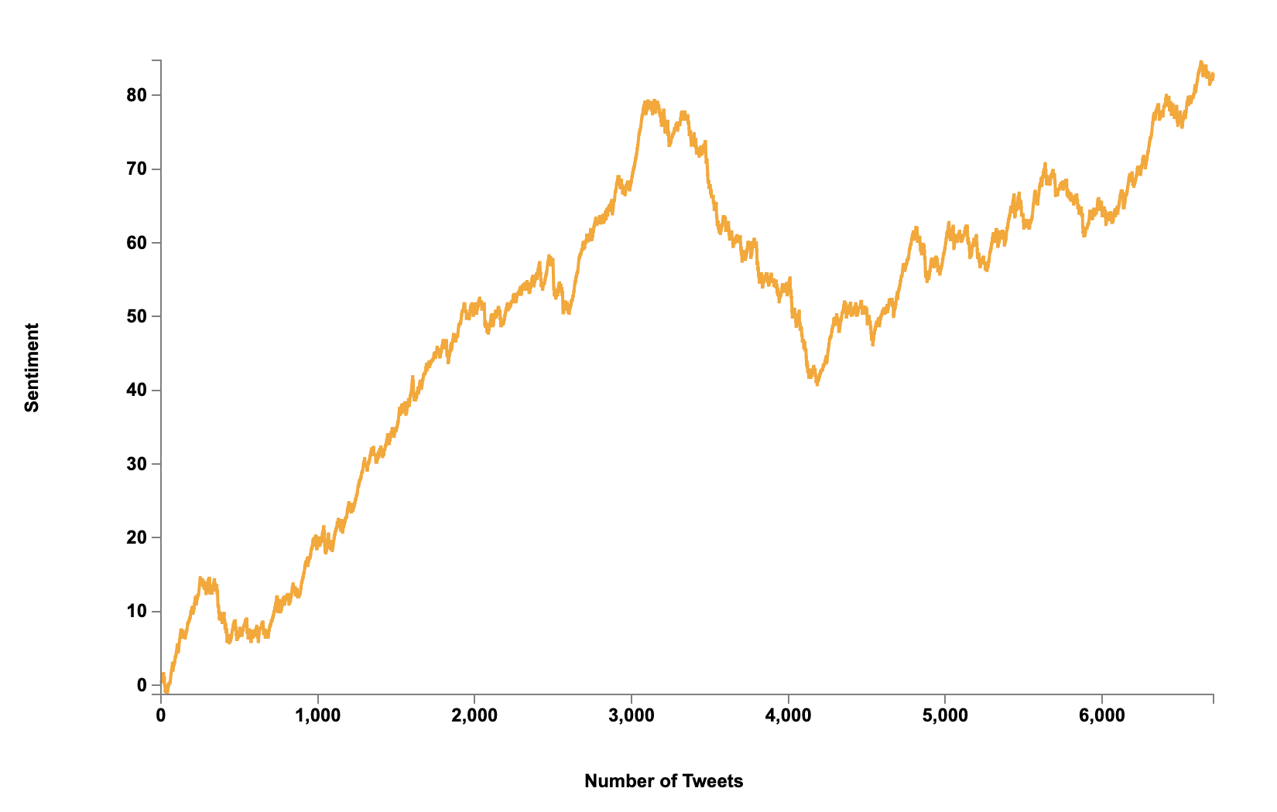
CRYPTOIntel
Tushar Chand Kapoor
Mehak Parashar
Syed Ikram
MOTIVATION
DATA SCIENCE PIPELINE
Data Collection
Analysis & Visualization
Machine Learning
Live streaming
LSTM
Data
Cleaning

Slide 3
GOALS
INTERACTIVE DASHBOARD
Data Collection
Analysis & Visualization
Machine Learning
Live streaming
LSTM
Data
Cleaning

